Slide 1

Personify
INVESTMENT STRATEGY AND PROJECT OVERVIEW

Slide 2

Why is it needed?
Paying bills on time is an essential skill to learn in terms of reaching financial freedom and effective way of leading personal finance.
The availability of well-structured payment statistics empowers users to manage their personal finances in the most efficient way.

Slide 3
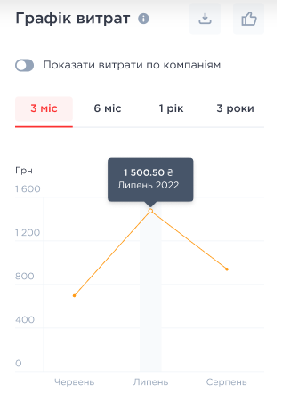




COMPETITION
Online bills payment
Payment templates
Statistics
Detailed statistics
Available statistics doesn’t tell anything.

Slide 4
UNIQUE SELLING PROPOSITION
Using benefits of ‘Personify’ step by step:
1
2
3
4
PAYING BILLS
TRACKING HISTORY
EXPENSES ANALYSiS
MONEY SAVING
Intuitive UI allows to pay all bills easily and free of charge.
Personal cabinet keeps all accruals and payments were made.
Detailed factor analysis provides valuable insights that are crucial for optimizing and reducing costs.
Using saved money for further investments or vacation.
Standard functionality
Extended functionality
‘Personify’ functionality

Slide 5

TARGET CUSTOMERS
1.2 million households are the potential clients in Kyiv.
Start point
Future Scaling
million households

Slide 6
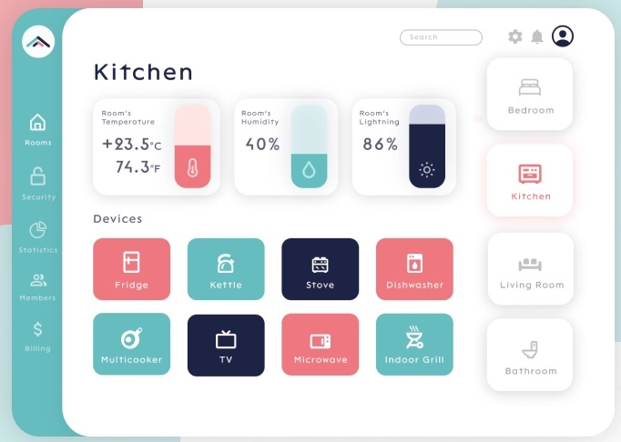
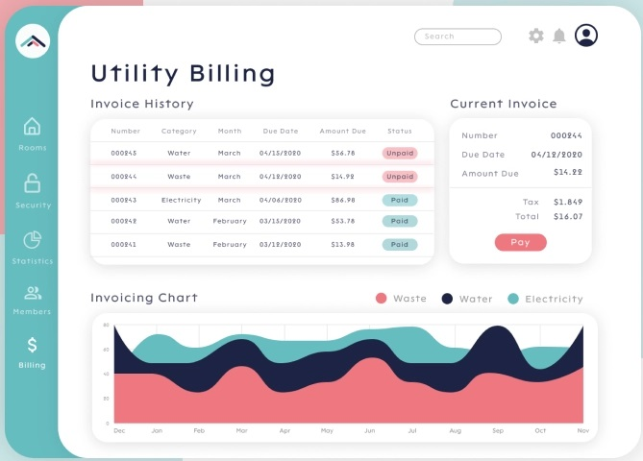
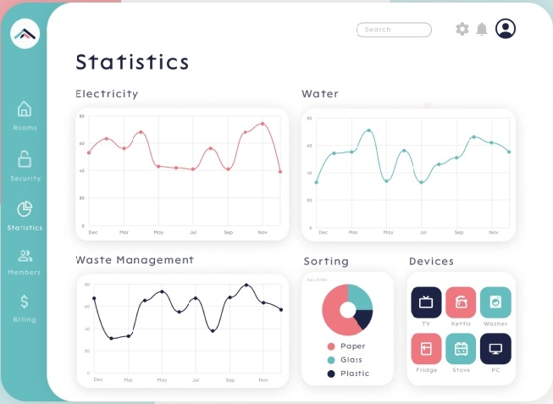

Slide 7
GRAPHS EXAMPLE

Slide 8
SCALING POSSIBILITIES
1.
2.
3.
As the service supplier has different subsidiaries with different bank accounts, there is a possibility to expand the app's functionality to all regions of Ukraine by adding local utilities suppliers.
Possibilities to cooperate with unions of owners of multiple houses (ОСББ). In tandem with the previous scaling point, would provide an increase in the target audience to 14.7 million.
Providing similar platform for legal entities to make utilities expenses analysis more convenient.
EXPANDING TERRITORY
ADDING UQMH
ENTERPRISES CONNECTION

Slide 9




HOW TO MAKE A PROFIT?
PREMIUM SUBSCRIPTION
Extended statistics and cost reducing advises.
ADVERTISMENT SECTIONS
Cooperation with partners.
‘PERSONIFY’ INTEGRATION
Allowing access to app from different services.

Slide 10



BOOTSTRAPPING
LOANS
LOOKING FOR ‘ANGELS’
CROWDFUNDING
The possibility of obtaining bank loans or credits to finance project.
Investors who invest their own funds and time in numerous innovative developments and promising projects in order to support young companies.
Using crowdfunding platform for raising the capital by describing all benefits of the project.

Slide 11
SOFTWARE DEVELOPMENT TEAM
Product Owner
Project Manager
DA team
BA team
Developers
Designers
QA team

Slide 12


FUTURE DEVELOPMENT STRATEGY
Action plan for the next 6 month:
Step 1
Step 2
Step 3
Collaboration with services suppliers in terms of sharing customers accruals data.
Increasing of the coverage area, adding new cities etc.
Adding unions of owners of multiple houses as services suppliers.

Slide 13

Thanks for watching!

